Slide 1
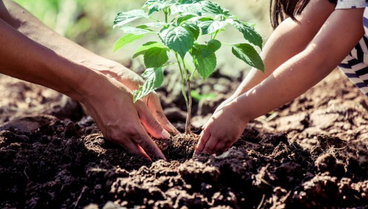

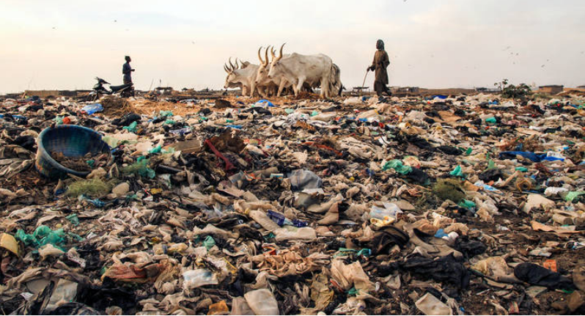
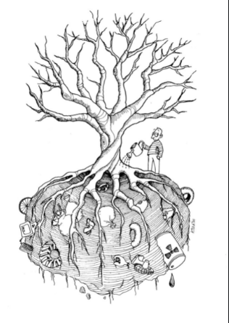
SOIL POLLUTION

Slide 2
CONTENTS
INTRODUCTION
TYPES OF SOIL POLLUTION
CAUSES
EFFECTS
CASE STUDY 1
CASE STUDY 2
PREVENTIONS

Slide 3

Soil pollution is the presence of toxic chemicals (pollutants or contaminants) in soil, in high enough concentrations to pose a risk to human health and/or the ecosystem. Soil pollution has increased over the last decades. When the amounts of soil contaminants exceed natural levels is also the causes of soil pollution . All soils, whether polluted or unpolluted, contain a variety of compounds (contaminants) which are naturally present. Such contaminants include metals, inorganic ions and salts (e.g. phosphates, carbonates, nitrates), and many organic compounds (such as lipids, proteins, DNA, fatty acids, hydrocarbons, PAHs, alcohols, etc.). These compounds are mainly formed through soil microbial activity and decomposition of organisms (e.g., plants and animals) When the amounts of soil contaminants exceed natural levels (what is naturally present in various soils), pollution is generated
INTRODUCTION

Slide 4
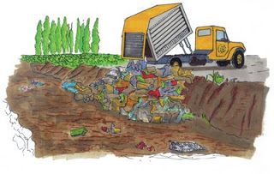
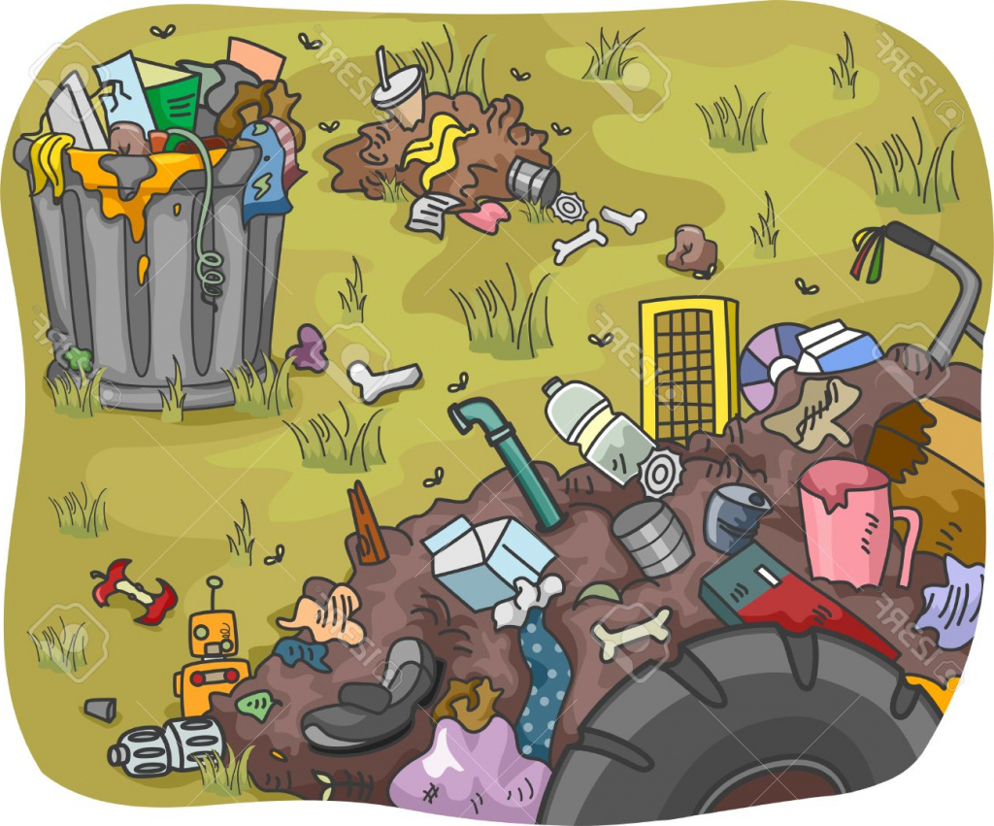
Soil quality monitoring may be a hard task due to the lack of well-stated monitoring variables and indicators. On the other hand, the pressure on soil quality and the need for sustainability of soil fertility is ever increasing due to the issues related to the world’s population increase. Therefore, due to the combination of all the above-mentioned issues, the soil pollution becomes a important topic.
Common contaminants include pesticides, petroleum products, lead, chromated copper arsenate and creosote.
Pesticides are quite frequently used to -control several types of pests now-a-days. Pesticides may exert harmful effects to micro-organisms, as a result of which plant growth may be affected. Pesticides which are not rapidly decomposed may create such problems. Some comman pesticides are DDT, 2,4D, AND 2,3 6-Trichlorobenzene (TBA)

Slide 5
Specific pollution: accounted for by particular causes, occurring in small areas the reasons for which can be easily identified. Land pollution such as this is normally found in cities, old factory sites, around roadways, illegal dumps and sewage treatment stations. Widespread pollution: covers extensive areas and has several causes the reasons for which are difficult to identify. Cases such as these involve the spreading of pollutants by air-ground-water systems and seriously affect human health and the environment.
TYPES OF SOIL POLLUTION

Slide 6
CAUSES
INDUSTRIAL ACTIVITY: It has been the biggest contributor to the problem in the last century, especially since the amount of mining and manufacturing has increased. Whether it is iron ore or coal, the by-products are contaminated, and they are disposed in a manner that is not considered safe. Thermal power plants generate a large quantity of ‘Fly ash ’ . Huge quantities of these wastes are dumped in the soil, thus contaminating them. Industrial wastes also contain some inorganic compounds like lead and mercury that are refractory and non-biodegradable.
AGRICULTURE ACTIVITY: Pesticides are used to kill pests that damage crops . These pesticides ultimately reach the soil and persist there for a long time. Pesticides which are persistent in nature are DDT, heptachlor etc. By excess use of (NH)2(SO4), (SO4)²⁻ accumulates into the soil and makes it infertile due to acidity. Similarly repeated use of fertilizers like KNO3 and NaNO3 causes accumulation of Na⁺ , K⁺ and leads to alkalinity of soil.

Slide 7
WASTE DISPOSAL: While industrial waste is sure to cause contamination, there is another way in which we are adding to the pollution. Every human produces a certain amount of personal waste products by way of urine and feces. While much of it moves into the sewer system, there is also a large amount that is dumped directly into landfills. Even the sewer system ends at the landfill , where the biological waste pollutes the soil and water.
ACCIDENTAL OIL SPILLS: It may happen during storage, transport or use of chemicals (e.g. leaks and spills of gasoline and diesel at gas stations). The chemicals present in the fuel deteriorates the quality of soil and make them unsuitable for cultivation. These chemicals can enter into the groundwater through the soil and make the water undrinkable.
ACID RAIN: It is caused when pollutants present in the air mix up with the rain and fall back on the ground. The polluted water could dissolve away some of the essential nutrients found in soil and change the structure of the soil.
RADIOACTIVE SUBSTANCES: The sources of radioactive substances in soil are explosion of radioactive devices, radioactive wastes discharged from industries and laboratories, aerial fall out etc. Isotopes of radium, uranium, thorium, strontium, iodine, caesium and of many other elements reach the soil and persist there for along time and keep on emitting radiations.

Slide 8
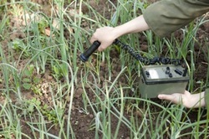
SOIL POLLUTION
EFFECTS
HEALTH EFFECTS
ECOSYSTEM EFFECTS

Slide 9
HEALTH EFFECTS
Contaminated or polluted soil directly affects human health through direct contact with soil or via inhalation of soil contaminants which have vaporized, potentially greater threats are posed by the infiltration of soil contamination into groundwater aquifers used for human consumption, sometimes in areas apparently far removed from any apparent source of above ground contamination. This tends to result in the development of pollution-related diseases . For example
Chronic exposure to chromium, lead and other metals, petroleum, solvents, and many pesticide and herbicide formulations can be carcinogenic, can cause congenital disorders, or can cause other chronic health conditions.
Chronic exposure to benzene at sufficient concentrations is known to be associated with higher incidence of leukemia.
Mercury and cyclodienes are known to induce higher incidences of kidney damage and some irreversible diseases.
PCBs and cyclodienes are linked to liver toxicity.

Slide 10
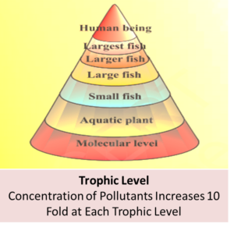
Ecosystem effects
Not unexpectedly, soil contaminants can have significant deleterious consequences for ecosystems . There are radical soil chemistry changes which can arise from the presence of many hazardous chemicals even at low concentration of the contaminant species. These changes can manifest in the alteration of metabolism of endemic microorganisms and arthropods resident in a given soil environment. The result can be virtual eradication of some of the primary food chain, which in turn could have major consequences for predator or consumer species..

Slide 11
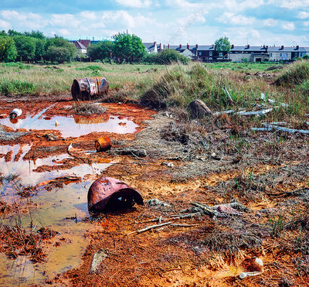
Case Study 1:
Soil Pollution by Toxic Metals near E-waste Recycling Operations.
Location: Nigeria

Slide 12
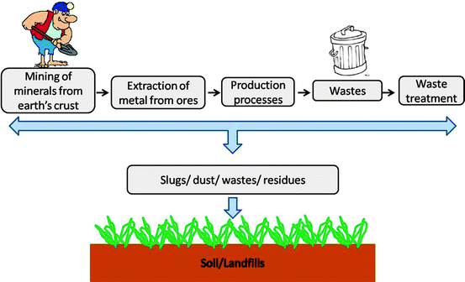
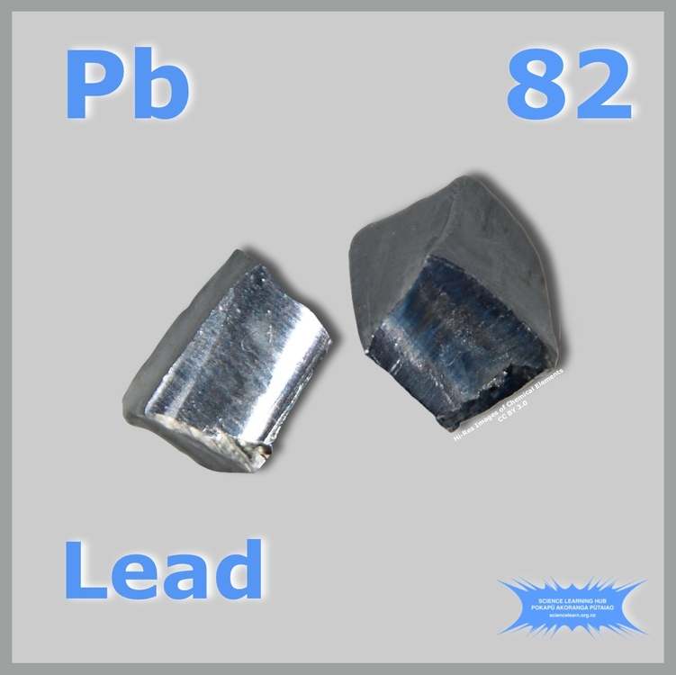
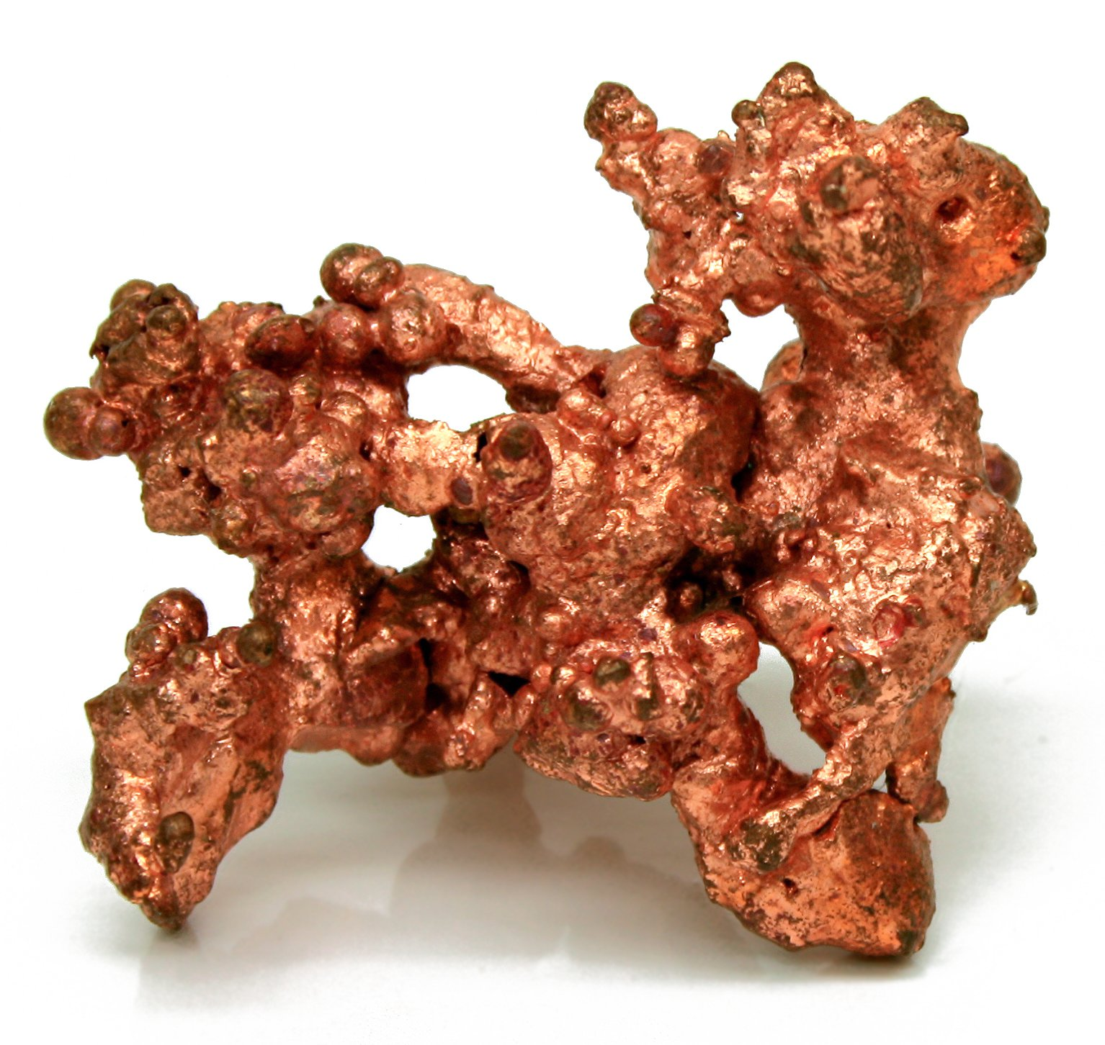
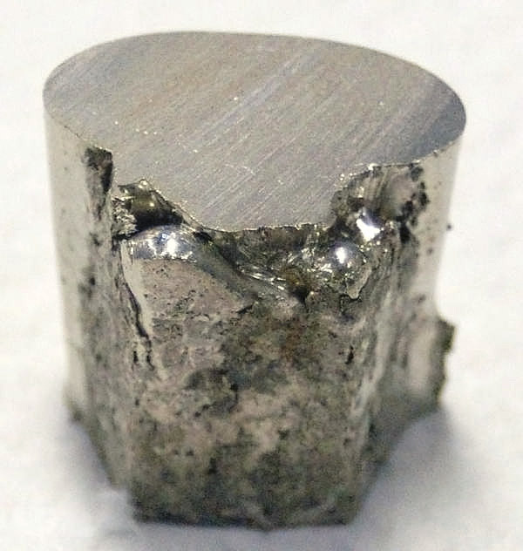
INTRODUCTION.
Nigeria and other West African countries like Ghana have come into global focus for e-waste dumping and/or management issues. Not only does Nigeria generate an estimated 1.2 million tons of assorted e-waste annually, it also receives about 40,000 monthly tons of e-waste and EEE near end-of-life from abroad. Most of the e-waste in Nigeria is normally dumped with the municipal solid waste stream and subsequently scavenged by the informal sector for recycling using environmentally unsound methods

Slide 13
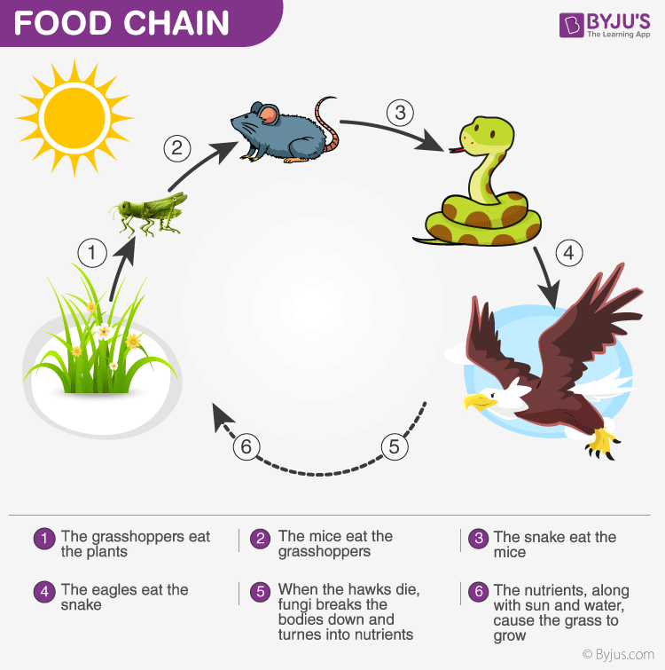
Unsound recycling of e-waste releases toxic metals into environmental media and has deleterious health consequences to humans as the metals transfer to humans through the food chain, direct contact and inhalation.

Slide 14
OBJECTIVES:
This study was therefore carried out to:
(i) determine the concentrations of environmentally available Pb, Cu, Cr, Ni and Cd in soils collected from high-, medium- and low-activity crude recycling activities in the Ogunpa area of Ibadan, Nigeria;
(ii) conduct speciation studies on selected soil samples that show high concentrations of metals to determine concentrations in the various phases; and
(iii) compare the concentrations of metals determined with background concentrations and regulatory limits to show the extent of pollution.

Slide 15
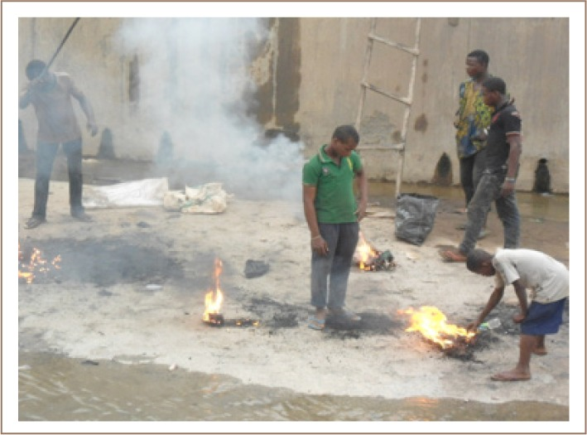
Methods
Description of Study Area
Ogunpa Market is one of the biggest markets within Ibadan Metropolis where used EEE and automobile spare parts are sold. The site is normally littered with informal e-waste recyclers. Activities such as manual dismantling of e-waste components without protection using simple tools like pliers, hammer, screw driver and open burning of plastics and PWBs to recover valuable metals like Cu characterize the site

Slide 16
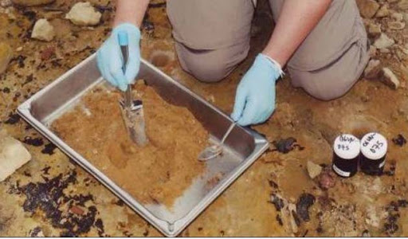
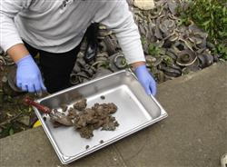
Sampling Design and Sample Collection
The site under consideration was divided into three sections: Section A - high activity (> 10 recyclers), Section B - medium activity (10 – 5 recyclers) and Section C - low activity (< 5 recyclers). Soils were collected from 3 points each for high, medium and low activity areas. Soil samples from a background location were collected in the same manner from the botanical garden of the University of Ibadan which is located within the same geographical region as the sampling site, but is influenced by little or no anthropogenic activities. A total of 48 soil samples were gathered from each of the sections (A, B, C) and background. Samples were packed in clean polythene bags and taken to the laboratory for further preparation and analyses.

Slide 17
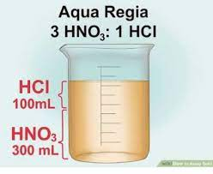
Sample Preparation and Analyses
All soil samples were air dried, pulverized and sieved through a 2 mm mesh size sieve and all soil properties were performed on < 2 mm soil samples.
Soil pH was performed, organic matter was determined, and soil particle size analysis was done by appropriate methods. Metals were leached from soil samples by modifying the method as follows:
2 g of soil were placed in a previously acid washed 100 mL Pyrex beaker, then 12 mL of HCl + 4 mL of HNO3 were added to the beaker in the hood and immediately covered with a watch glass. This mixture gave rise to aqua regia, a strong oxidizing solution that produces nascent chlorine that converts all organic components (carbon and hydrogen) to carbon dioxide and water.
This was placed in a water bath (95 – 100°C) and refluxed for 2 hours with intermittent shaking every 20 minutes. The leachate was filtered using Whatman No.1 filter paper and made up in an appropriate standard flask. The leachate was stored in an acid washed plastic bottle and kept in the fridge at 4°C prior to analysis. This was repeated for all other soil samples.
Following the sequential extraction procedure, Pb and Cu were partitioned into five fractions. The procedure was carried out with an initial weight of 1 g. Deionized water was used to prepare all reagents for each step.

Slide 18
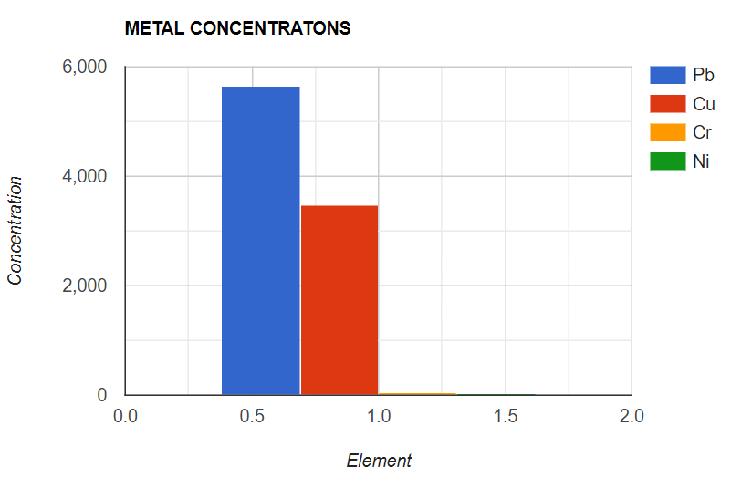
Concentration of Samples in the Soil.
Metal concentrations (mg/kg)
The average metal concentrations
generally followed the sequence
Pb > Cu >> Cr > Ni >> Cd.
Results.
The results indicated enrichment in soil by all metals, especially Pb and Cu, which were many times higher compared with background concentrations.
Additionally, average Pb and Cu concentrations were higher than regulatory limits for soil set by selected countries across the globe.
Speciation studies indicated that about 65% and 88% of Pb and Cu, respectively, were liable to potential mobility with slight changes in natural conditions.
Other metal concentrations, although with higher concentrations compared with background levels, were within the permissible limits in soils accepted by many countries across the globe.
There were significant correlations between all metals, suggesting that they may have been released from a common source.

Slide 19
ILL EFFECTS ON HUMAN BEINGS
Humans are exposed to pollutants arising from crude e-waste management through dermal contact, inhalation of burning smoke/dust and dietary intake through contaminated water and food.
Children and adults (especially lactating mothers) working or living near crude e-waste recycling sites are at risk of health problems related to e-waste. Children are more vulnerable to the toxic effects of these contaminants due to their high gastrointestinal uptake of heavy metals.
Increases in spontaneous abortions, premature births, and reduced birth weights in pregnant women exposed to heavy metals from e-waste sites have been documented.
Conclusions.
Regulations guiding e-waste recycling activities in Nigeria are urgently needed, along with cleanup of soils around Ogun pa which are polluted by Pb and Cu.

Slide 20
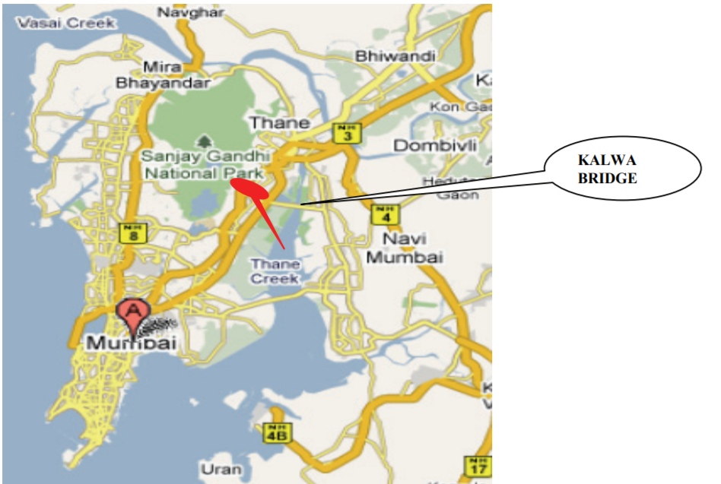
CASE STUDY-2
Soil Pollution along Kalwa Bridge at Thane Creek of Maharashtra

Slide 21
SOIL SAMPLING
Eighty soil samples were randomly collected along Kalwa bridge of Thane Creek for both dry and wet seasons and at different depths.
The soil samples were collected by hand-pushing plastic core tubes (7 cm diameter) as far as possible into the soil.

Slide 22
SAMPLE PREPARATION
Well-mixed samples of 2 g each were taken in 250 mL glass beakers and mixed with 8 mL of aqua regia(nitrohydrochloric acid)(mixture of HCl and nitric acid in 3:1 ratio) on a sand bath for 2 h.
After evaporation to near dryness, the samples were dissolved with 10 mL of 2% nitric acid, filtered through Whatman’s No.1 filter paper and then diluted with deionized water to give final volumes depending on the suspected level of the metals.

Slide 23
HEAVY METAL ANALYSIS
Heavy metal pollution alters the composition and activity of soil microbial communities.
Most commonly heavy metals are arsenic(As),Zinc(Zn),cadmium(Cd),coppper(Cu),Mercury(Hg).
Cd is considered to be one of the most toxic metal pollutants due to its its high mobility(especially in the soil having acidic ph value).

Slide 24
Average values of three replicates were taken for each determination.

Slide 25
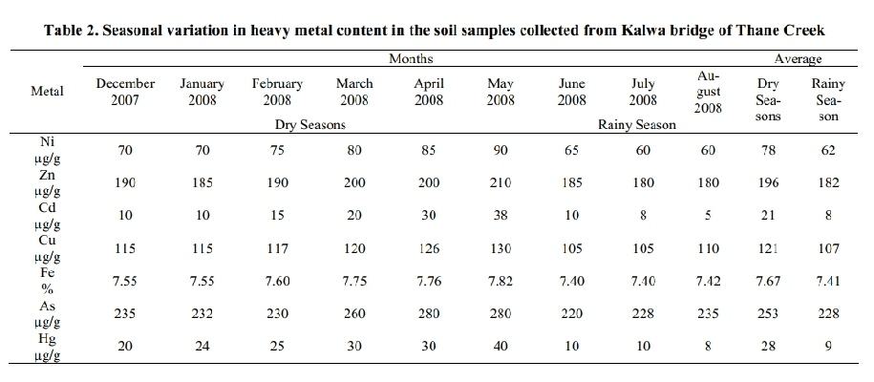
RESULTS

Slide 26
CONCLUSION
The experimental data on the soil pollution status along the Kalwa bridge of Thane creek suggest a need to implement common objectives, compatitable policies and programmes for improvement in the industrial waste water treatment methods. The high level of pollution along the creek area also suggest a need of consistent, internationally recognized data driven strategy to assess the quality of aquatic body and generation of international standards for evaluation of contamination levels. If the present conditions continue for a long period, the Thane creek area may soon become ecologically inactive.

Slide 27
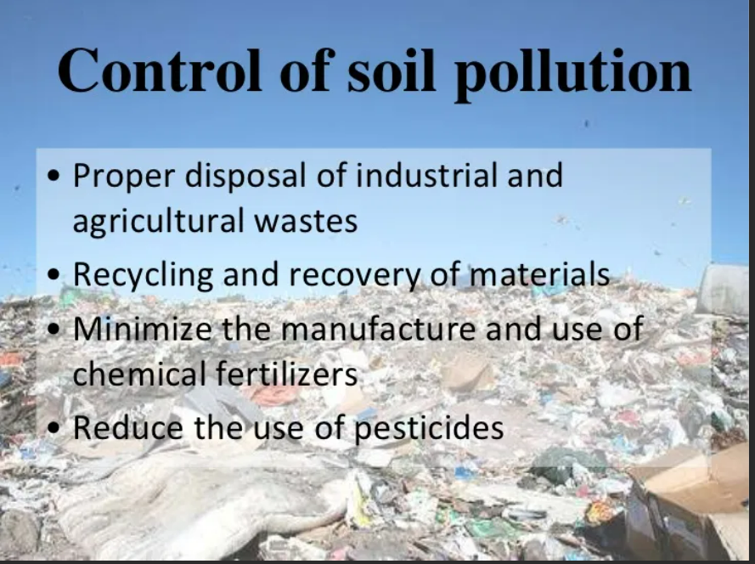
WAYS OF PREVENTING SOIL POLLUTION
1) Proper Treatment of the Solid Waste
2) Reduction of Toxic Chemicals
3) three R’s: Reduce, Reuse, and Recycle
4) Use of pesticides should be minimized.
5) Use of fertilizers should be judicious.
6) Cropping techniques should be improved to prevent growth of weeds.
7) Special pits should be selected for dumping wastes.
8) Controlled grazing and forest management.

Slide 28
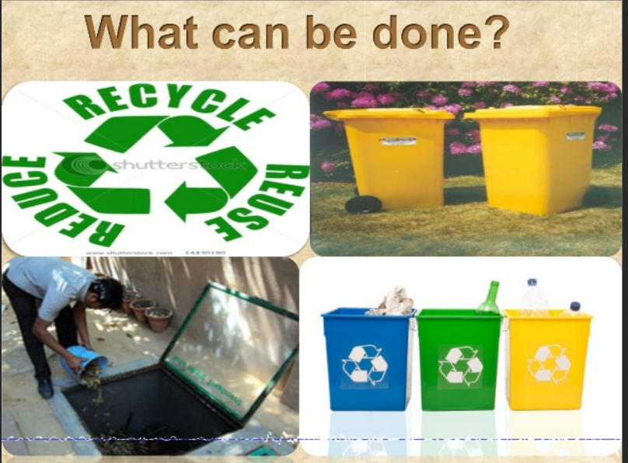
Control of Soil Pollution:
In general we would need less fertilizer and fewer pesticides if we could all adopt the three R’s: Reduce, Reuse, and Recycle. This would give us less solid waste.
Reducing chemical fertilizer and pesticide use:
Applying bio-fertilizers and manures can reduce chemical fertilizer and pesticide use. Biological methods of pest control can also reduce the use of pesticides and thereby minimize soil pollution.
Reusing of materials:
Materials such as glass containers, plastic bags, paper, cloth etc. can be reused at domestic levels rather than being disposed, reducing solid waste pollution.
Recycling and recovery of materials:
This is a reasonable solution for reducing soil pollution. Materials such as paper, some kinds of plastics and glass can and are being recycled. This decreases the volume of refuse and helps in the conservation of natural resources. For example, recovery of one tone of paper can save 17 trees:

Slide 29
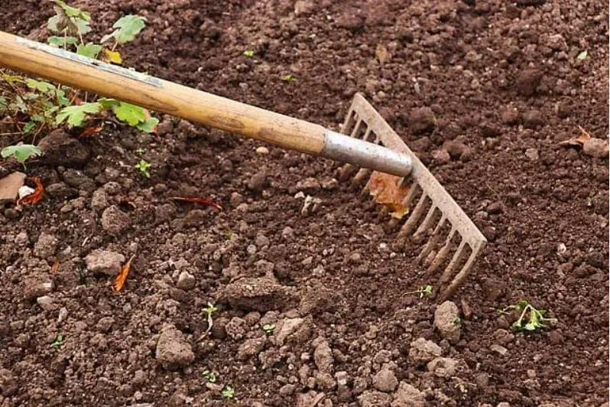
Proper Treatment of the Solid Waste:
It is vital to properly treat the solid waste before disposing and releasing it into the environment. Alkaline and acidic waste and biodegradable waste should be treated and broken down into smaller components before releasing it into the soil. Treatment of the sludge from the sewers is a great example of solid waste disposal. First of all the waste materials should be divided according to the contamination degree. Mild or moderate materials should be treated in a controlled facility while heavily contaminated ones should be treated in a strict treatment facility.
Reduction of Toxic Chemicals:
The waste that is released into the soil should include less toxic chemicals. This can be accomplished by treating the wastes with different chemicals to reduce the toxicity levels. Once it is done, it can be dispensed into the soil using responsible systems.

Slide 30
THANK YOU EVERYONE
ASSIGNED BY: PROF. SAMRITI BANSAL
PREPARED AND PRESENTED BY:
ABISHEK KUMAR (2020UCO1666)
ADARSH KUMAR (2020UCO1663)
AMAN SONI (2020UCO1711)
AMOGH GARG (2020UCO1688)
PIYUSH SINGH (2020UCO1700)
ROHIT SHARMA (2020UCO1697)
VISHAL VERMA (2020UCO1648)
YASH JINDAL (2020UCO1689)

